Slide 1

Shreemathi D
Final Project
3/21/2024 Annual Review
1

Slide 2


YOUTUBE VIDEO SUMMARIZATION WITH TRANSFORMERS
3/21/2024 Annual Review
1

Slide 3



AGENDA
Problem Statement
Project Overview
End Users
Value Proposition
Solution
Modelling
Results
3/21/2024 Annual Review
3

Slide 4

PROBLEM STATEMENT
The problem addressed in this project is the need for efficient summarization of lengthy YouTube video transcripts. By automating the process of extracting and condensing information from these transcripts, the project aims to provide users with concise summaries, enhancing content consumption and saving time. This involves leveraging libraries such as the YouTube Transcript API and Transformers to process and summarize video content effectively.
3/21/2024 Annual Review
4

Slide 5

PROJECT OVERVIEW
The project aims to streamline the process of extracting key information from YouTube videos, enhancing user experience and productivity. The main object is to automates the extraction and summarization of YouTube video transcripts using the YouTube Transcript API and the Transformers library. It retrieves transcripts, concatenates them, and iteratively summarizes them to provide concise summaries. The process involves setting up the environment, installing necessary libraries, retrieving the video transcript, and creating a summarization pipeline. The summarized text is generated and concatenated for efficient content consumption.
3/21/2024 Annual Review
4

Slide 6

WHO ARE THE END USERS?
Content Consumers - Individuals seeking concise insights from YouTube videos without watching them in full.
Content Creators - YouTube creators offering summarized versions of their lengthy videos to cater to diverse audience preferences.
Educational Institutions - Facilitating faster comprehension of educational videos by providing summarized versions to students.
Researchers - Extracting relevant information efficiently from videos for integration into research projects.
Media and Marketing Professionals - Analyzing competitor videos and extracting key insights for content strategy enhancement.
3/21/2024 Annual Review
4

Slide 7

YOUR SOLUTION AND ITS VALUE PROPOSITION
The solution presented in this project automates the process of summarizing YouTube video content by leveraging the Transformers library for text summarization and the YouTube Transcript API for transcript extraction. This solution offers several key value propositions:
Efficiency - Automates summarization of YouTube videos, saving time and effort.
Accuracy - Utilizes advanced natural language processing models for precise summarization.
Scalability - Handles transcripts of any length, ensuring adaptability to various video durations.
User-Friendly - Offers easy input of YouTube links and accessible summarized text output.
Versatility - Applicable to diverse use cases, facilitating quick comprehension of video content.
3/21/2024 Annual Review
4

Slide 8

THE WOW IN YOUR SOLUTION
The wow lies in seamlessly integrating cutting-edge tech like Transformers and YouTube Transcript API for automated YouTube video summarization. Leveraging Transformers' NLP and Transcript API's retrieval, users get swift, concise summaries. Iterative summarization guarantees accuracy and depth, boosting user experience and productivity. Python scripting offers flexibility, tailoring to specific needs, boosting adaptability and efficacy.
3/21/2024 Annual Review
10

Slide 9
MODELLING
Text Summarization Pipeline Initialization -Initializes a summarization pipeline using the Transformers library to condense lengthy transcripts into concise summaries.
Iterative Text Summarization - Divides the original transcript into segments, applies summarization iteratively to each segment, and generates summarized text to handle long transcripts effectively.
Concatenation of Summarized Text - Combines the summarized text segments to create a comprehensive summary of the entire transcript, ensuring all key information is retained.
Length Calculation -Evaluates the effectiveness of the summarization process by calculating the length of the summarized text, providing insights into the degree of condensation achieved.
3/21/2024 Annual Review
10

Slide 10
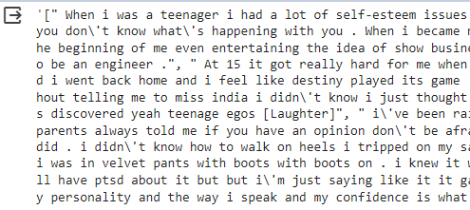
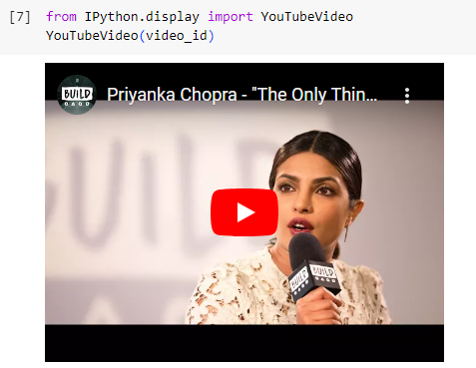
RESULTS
The results of the project involve successfully installing the required libraries, retrieving and processing the transcript of a YouTube video, and generating summarized text segments using a text summarization pipeline.
https://github.com/Shreemathi-D/Naanmudhalvan-GENAI.git
3/21/2024 Annual Review
10

